Slide 1
Deadlock

Slide 2
Deadlock Prevention And Avoidance
We can prevent Deadlock by eliminating any of the below four conditions.
Mutual Exclusion
Hold and Wait
No preemption
Circular wait

Slide 3
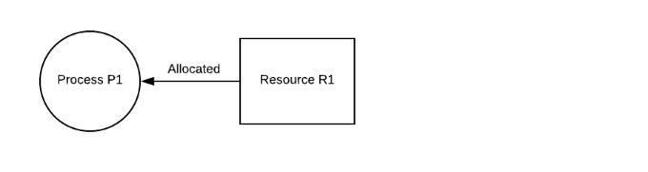
Mutual Exclusion
There should be a resource that can only be held by one process at a time. In the diagram below, there is a single instance of resource R1 and it is held by process P1 only.

Slide 4
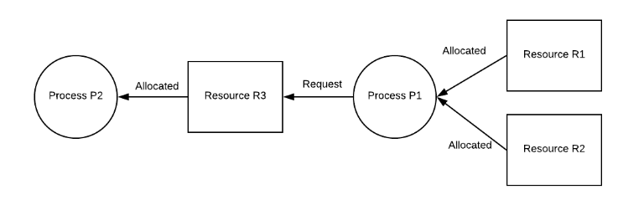
Hold and Wait
A process can hold multiple resources and still request more resources from other processes which are holding them. In the diagram given below, process P1 holds resources R1 and R2 and is requesting the resource R3 which is held by process P2.

Slide 5
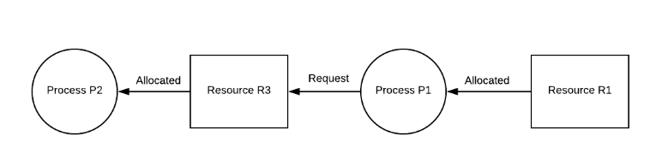
No Preemption
A resource cannot be preempted from a process by force. A process can only release a resource voluntarily. In the diagram below, process P1 cannot preempt resource R3 from Process P2. It will only be released when P2 relinquishes it voluntarily after its execution is complete.

Slide 6
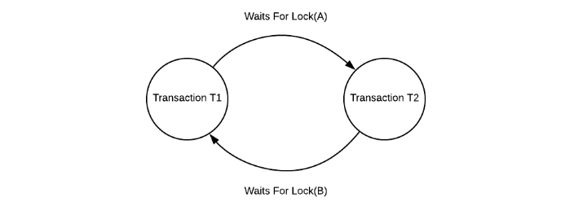
Circular Wait
A process is waiting for the resource held by the second process, which is waiting for the resource held by the third process and so on, till the last process is waiting for a resource held by the first process. This forms a circular chain. For example: Process P1 is allocated resource R1 and it is requesting resource R2. Similarly, process P2 is allocated resource R2 and it is requesting resource R1. This forms a circular wait loop.

Slide 7
Deadlock detection & Avoidance
It is better to avoid a deadlock rather than take measures after the deadlock has occurred. The wait for graph can be used for deadlock avoidance. This is however only useful for smaller databases as it can get quite complex in larger databases.
Wait for graph
The wait for graph shows the relationship between the resources and transactions. If a transaction requests a resource or if it already holds a resource, it is visible as an edge on the wait for graph. If the wait for graph contains a cycle, then there may be a deadlock in the system, otherwise not.

Slide 8
Deadlock Prevention
It is imperative to prevent a deadlock before it can occur. So, the system rigorously checks each transaction before it is executed to make sure it does not lead to deadlock.
If there is even a chance that a transaction may lead to deadlock, it is never allowed to execute.
Wait - Die Scheme
Wound - Wait Scheme

Slide 9
Wait - Die Scheme
If a transaction T1 requests for a resource that is held by transaction T2, one of the following two possibilities may occur:
TS(T1) < TS(T2) - If T1 came in the system earlier than T2 and T2 has held some resource, then it allows T1 to wait until resource is available for execution when T2 has completed its execution.
TS(T1) > TS(T2) - If T1 is younger than T2 i.e T1 came in the system after T2, then T1 is killed. It is restarted later with the same timestamp.

Slide 10
Wound - Wait Scheme
If a transaction T1 requests for a resource that is held by transaction T2, one of the following two possibilities may occur:
TS(T1) < TS(T2) - If T1 is older than T2 i.e T1 came in the system earlier than T2, then it is allowed to roll back T2 or wound T2. Then T1 takes the resource and completes its execution. T2 is later restarted with the same timestamp.
TS(T1) > TS(T2) - If T1 is younger than T2 i.e T1 came in the system after T2, then it is allowed to wait for the resource which will be free when T2 has completed its execution.

Slide 11
Recovery from Deadlock
When a Deadlock Detection Algorithm determines that a deadlock has occurred in the system, the system must recover from that deadlock. There are two approaches of breaking a Deadlock.
Process Termination
Resource Preemption

Slide 12
Process Termination: To eliminate the deadlock, we can simply kill one or more processes.
Abort all the Deadlocked Processes: Aborting all the processes will certainly break the deadlock, but with a great expense. The deadlocked processes may have computed for a long time and the result of those partial computations must be discarded and there is a probability to recalculate them later.
Abort one process at a time until deadlock is eliminated: Abort one deadlocked process at a time, until deadlock cycle is eliminated from the system. Due to this method, there may be considerable overhead, because after aborting each process, we have to run deadlock detection algorithm to check whether any processes are still deadlocked.

Slide 13
Resource Preemption: To eliminate deadlocks using resource preemption, we preempt some resources from processes and give those resources to other processes. This method will raise three issues.
Selecting a victim: We must determine which resources and which processes are to be preempted and also the order to minimize the cost.
Rollback: We must determine what should be done with the process from which resources are preempted. One simple idea is total rollback. That means abort the process and restart it.
Starvation: In a system, it may happen that same process is always picked as a victim. As a result, that process will never complete its designated task. This situation is called Starvation and must be avoided. One solution is that a process must be picked as a victim only a finite number of times.

